Slide 1

Islamic Studies
Qiyas (Assignment 3)
Zunaira Abdul Aziz
BSSE23058

Slide 2
Scenrio
Ahmed, a young entrepreneur in a developing country, has a promising business idea but lacks the necessary capital to turn his vision into reality. He approaches a conventional bank for a business loan to fund his venture. The bank offers him a substantial loan with an interest rate that seems reasonable at first glance.

Slide 3
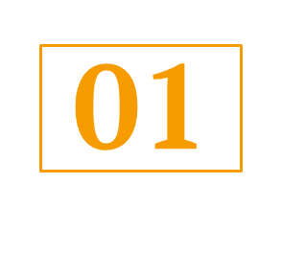
Asl
Those who consume interest will stand ˹on Judgment Day˺ like those driven to madness by Satan’s touch. That is because they say, “Trade is no different than interest.” But Allah has permitted trading and forbidden interest. Whoever refrains—after having received warning from their Lord—may keep their previous gains, and their case is left to Allah. As for those who persist, it is they who will be the residents of the Fire. They will be there forever.
"Narrated Jabir bin `Abdullah: Allah's Messenger (ﷺ) cursed the accepter of interest and its payer, and one who records it, and the two witnesses; and he said: They are all equal (in sin).“
Surah Al-Baqarah (2:275-279)
Sahih Bukhari, Volume 3, Book 34, Hadith 299

Slide 4
02
03
04
Fra’
Interest, known as Riba, is prevalent in modern financial systems, manifesting in various forms such as loans, mortgages, and credit arrangements.
Illet
The effective cause behind the prohibition of Riba in Islam is to prevent exploitation and ensure economic justice. Riba leads to unfair advantages for lenders, exacerbating economic disparities and hindering the equitable distribution of wealth.
Hukam
Prohibited

Slide 5
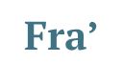
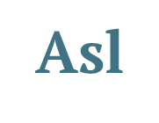
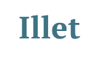
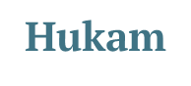
Interest, known as Riba, is prevalent in modern financial systems, manifesting in various forms such as loans, mortgages, and credit arrangements. | "Narrated Jabir bin `Abdullah: Allah's Messenger (ﷺ) cursed the accepter of interest and its payer, and one who records it, and the two witnesses; and he said: They are all equal (in sin).“ | The effective cause behind the prohibition of Riba in Islam is to prevent exploitation and ensure economic justice. Riba leads to unfair advantages for lenders, exacerbating economic disparities and hindering the equitable distribution of wealth. | Prohibited

